Slide 1
The experts for energy

Slide 2
Business Unit Power and Heat
EUR 50.7 million
sales in the past year 2021
860 projects
we realize on average per year
1,800 employees
are currently working in the business unit, of which approx. 1,500 at Encotec in India
Our services
contain among others:
Project management
Plant and process engineering
Electrical and control technology
Environment
Operation support services
Operational management
Milestones
General planning of CO2 separation at the waste incineration Delfzijl
Planning of energy centers In Potsdam, Krampnitz and Bochum
Owner’s engineering for the high voltage grid in the Gulf region

Slide 3
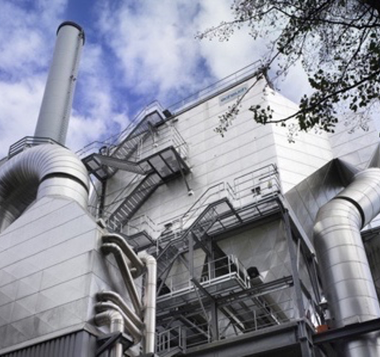
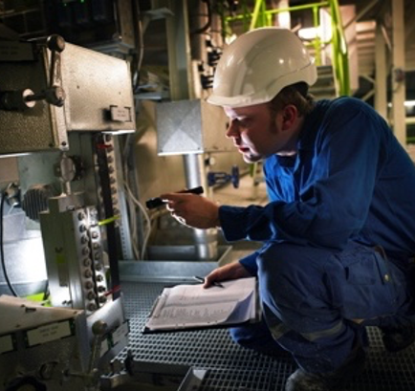
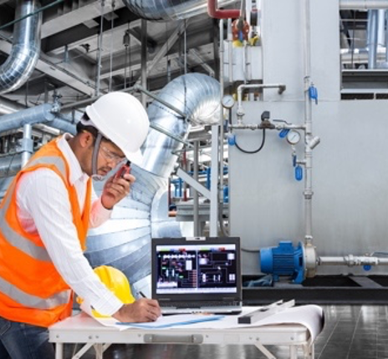
Our service areas at a glance
PROJECT MANAGEMENT
PLANT & PROCESS ENGINEERING
ELECTRICAL & CONTROL ENGINEERING
ENVIRONMENT
OPERATION SUPPORT SERVICE
OPERATIONAL MANAGEMENT
Project Management
Permit planning
Scheduling
Claim and cost management
Quality assurance
Plant design
Piping design
Civil Engineering Management
Calculations
Monitoring of process quality
Systems engineering
Environmental Technology
Mechanical Engineering
Boiler technology
Electrical and I&C planning
High Voltage Technology
Grids
Electric storage / hybrid systems
Environmental Consulting
Environmental Planning
Environmental assessment
Project and Permit management
Environmental Informatics
Maintenance services
Plant inspection
Process optimizations
Measurements & Optimization
Technical diagnostics / test engineering / materials engineering
Operation and maintenance services
Preventive maintenance
Condition monitoring
On-site services
Personnel services
Training for operating personnel

Slide 4
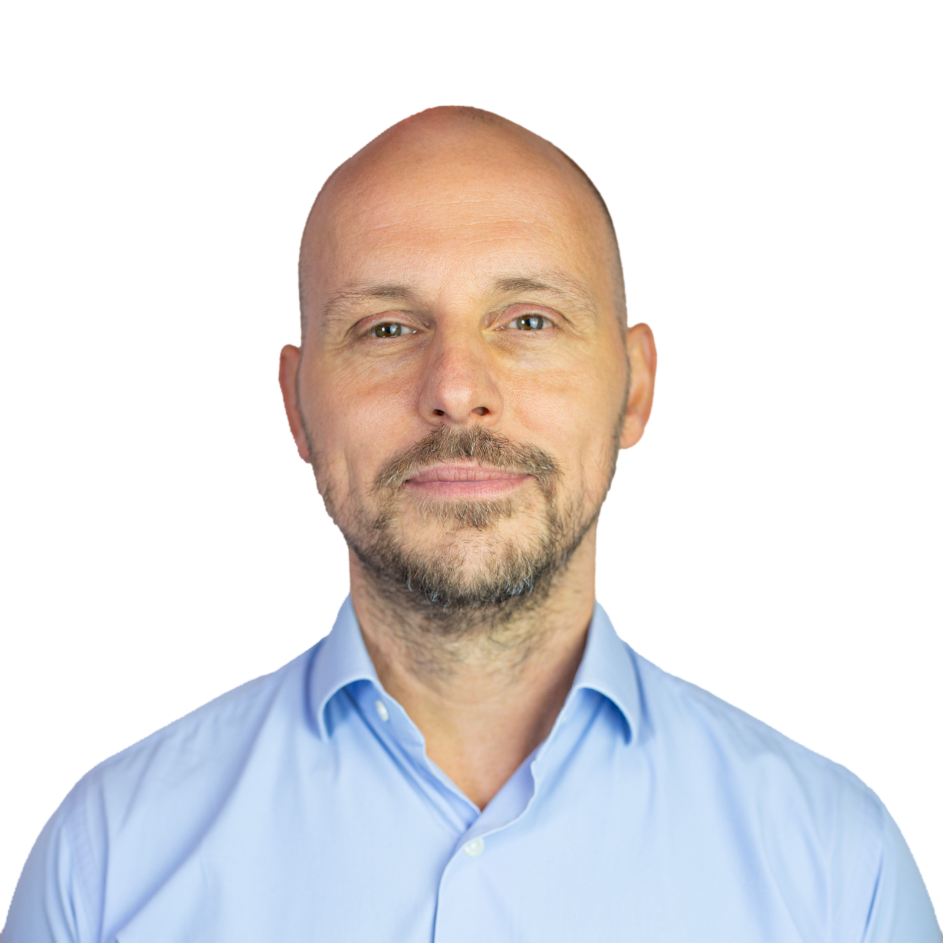
Project Management
Project Management
Project management
Permit planning
Claim & Cost Management
Scheduling and control
Safety management
Planning services for dismantling/overhaul of old plants
Plant design
Arrangement planning for the construction of industrial plants, especially power plants
Piping design
constructional project support
3D plant design (Aveva PDMS)
Disassembly planning
Risk assessments during planning
Your contact person:
Normen Seifert

Slide 5
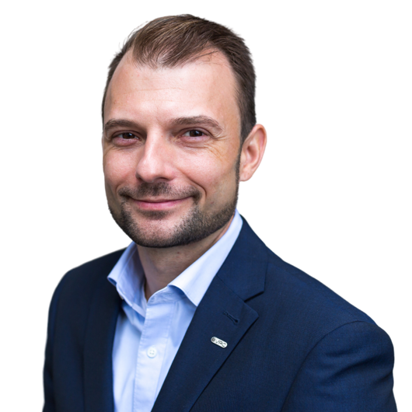
Plant and process engineering
Calculations / Performance Monitoring
Thermodynamic calculations with Ebsilon and Thermoflow
Performance monitoring (online and offline)
Boiler technology
Planning & consulting for new build plants and conversions
Support for the use of various fuels / fuel change
Quality assurance of materials
Operational support & operational optimization
Mechanical Engineering
Design, dimensioning and tendering of mechanical engineering components
Systems and environmental engineering
Planning of processes and systems
Function planning
Hazard and risk analysis
Planning for CHP and TEH Act
Water treatment & flue gas cleaning
Chemical storage and dosing
Your contact person:
Christian Klett

Slide 6
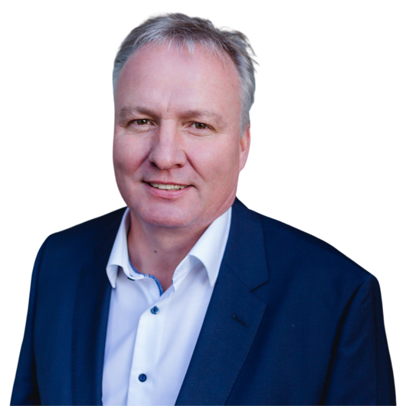
Electrical and control technology
Electrical and I&C planning
Studies & Concepts
Planning for new builds
Upgrading and plant optimization
Power distribution systems for low and medium voltage plants
Grid connections
Communication and security technology
KRITIS assessment
SIL assessment
Centralization of operating and monitoring equipment
High Voltage Technology
Design of distribution and transmission networks
Planning of primary and secondary technology for distribution networks and in the substation area
Condition assessments & asset upgrades, due diligence reports
Budget planning, technical planning, execution planning, support with approvals
Network calculations & network simulation
Your contact person:
André Zarse

Slide 7
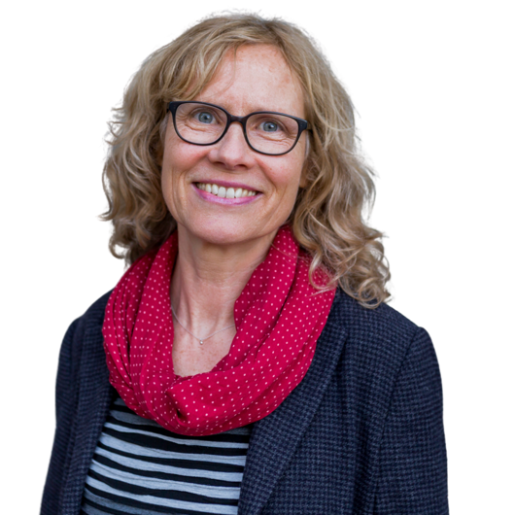
Environment
Environmental Consulting
Feasibility studies / comparison of variants
Award procedures according to VOL / VOB
Preparation for certification acc. to EfB regulation
Speaker activities
Environmental Planning
Conceptual planning
Landscape conservation plans
Environmental impact studies, remediation concepts
Environmental assessment
Assessment of environmental assets (UVPG), environmental impact studies, expert opinions and monitoring
Historical usage research
Orienting and detailed investigations for the risk assessment of objects of protection
Contamination and pollutant assessment
Environmental Informatics
Separation of wastewater charges (AQUA-Split - the software for recording and documenting property data, setting up and maintaining databases, customizing software, software maintenance)
Authority support (Argu.Web® - the database system for objection management)
Project and permit management
Support in approval procedures
Project management contaminated sites / land recycling
Introduction of separate fees for rainwater drainage ("wastewater fee splitting")
Your contact person:
Annette Wackerhagen

Slide 8
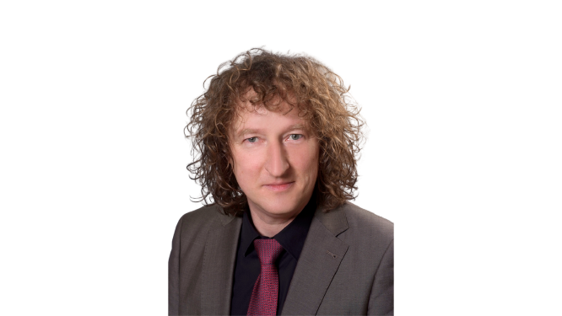
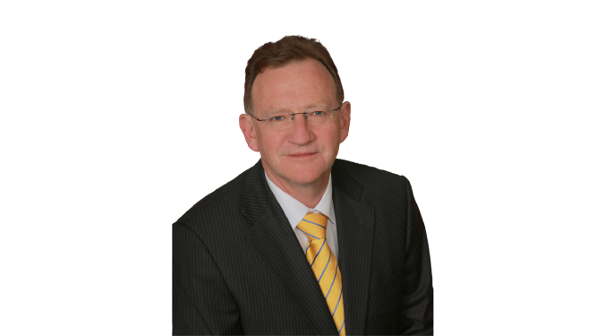
Operating service
Operational support services
Preparation, implementation and follow-up of inspection measures in power plants
Maintenance planning
Preparation of inspection books for all pressurized vessels requiring monitoring
Damage investigations; proposals for damage prevention
Technical operations management systems
Measurements & Optimizations
Energetic acceptance and control measurements
Plant measurements & investigations
Combustion analysis and optimization
Emission and immission measurements
Model calculations
Technical diagnostics / test engineering
Vibration measurements, modal analyses, FEM calculations, structural analyses
Sound measurements / calculations
Video endoscopy, thermography
Calibration laboratory (temperature and pressure)
He and H2 leak detection
Materials engineering
Destructive and non-destructive testing as part of maintenance measures on site and in the laboratory for damage investigation and service life monitoring
Materials engineering consulting and expert opinions
Quality assurance
Your contact persons:
Lutz Appelt (left)
Steffen Griebe (right)

Slide 9
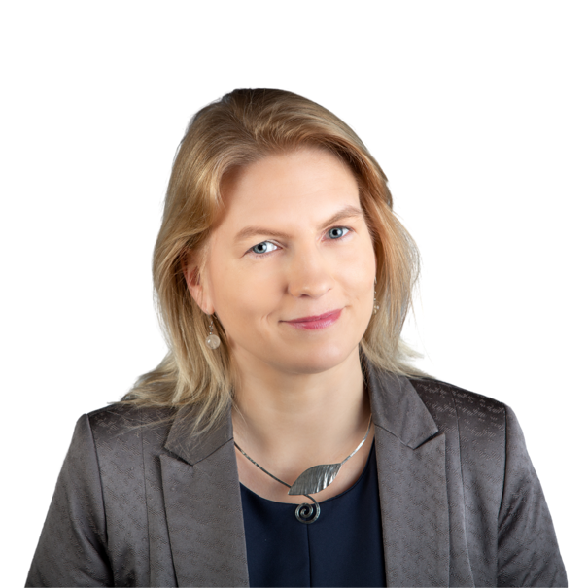
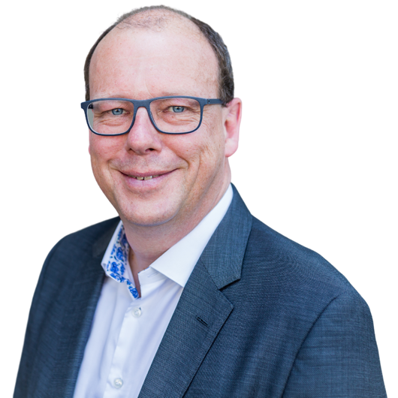
Operational management
Operational management
Technical management
Commercial management
Personnel training and assessment
Occupational safety, risk assessment
Software development for: [www.ibs-ibis.de]
Business organization and project management
Electronic operating documentation (operating diary, data acquisition, logistics, reporting, waste register, fault recording)
Maintenance platform: planning, organization, documentation, evaluation
Maintenance
Maintenance management (planning, coordination, monitoring)
Carrying out (mechanical, electrical & I&C)
Planning & project management of maintenance and rebuild projects in biomass/ and RDF power plants
Coordination and supervision of maintenance projects (technical, occupational safety)
Your contact persons:
Yvonne Groth
Ralph Thilo

Slide 10
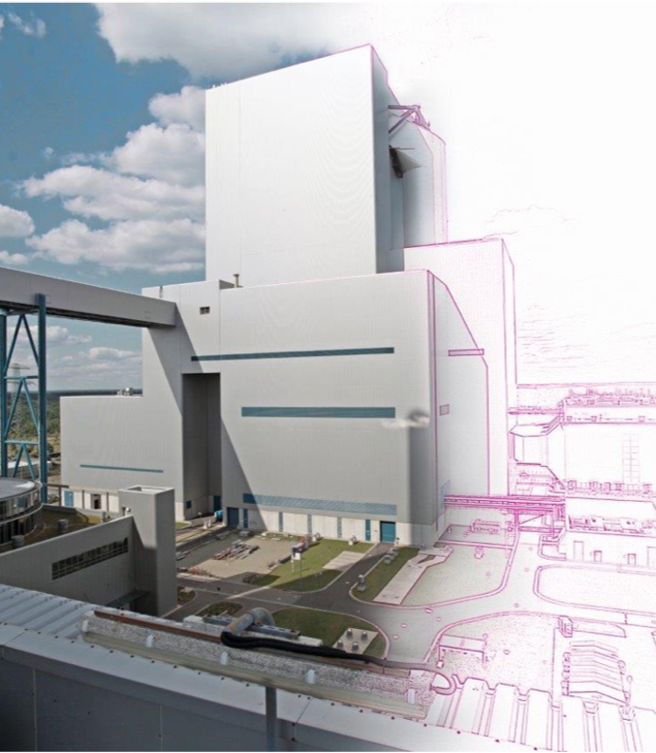
Over 60 years of experience from projects in the energy sector
Everything from a single source From the project idea to dismantling - you will receive project services with great planning depth over the entire life cycle.
Through the eyes of an operator Planning and management with an understanding of your concerns as a plant operator.
Independent and neutral No ties to suppliers or operators, the optimal result for you.

Slide 11
Hisham Ramahi
Business Relationship Manager
hisham.ramahi@dornier-group.com
00966565135876 00962796510519

Slide 12
Raed Romhi
Head of MENA region
Raed.romhi@dornier-group.com
+962 (0)77 9999 007 +971 (0)56 2299 007

Slide 13
André Zarse
Division Manager of Electrical- I&C
andre.zarse@dornier-group.com
+49 172 3517649

