Slide 1
The companions of the energy transition
______
Notes:
*Source: <a href="https://de.freepik.com/fotos-kostenlos/hoher-modellwinkel-fuer-erneuerbare-energien-mit-sonnenkollektoren_16713399.htm#query=renewables&position=41&from_view=search&track=sph">Freepik</a>

Slide 2
Business Unit Renewables
EUR 3.1 million
sales in 2021
70 projects
we realize on average per year
60 employees
are currently working in the business unit
Our services
contain among others:
Solar PV solutions, design and construction
Wind installation and major components replacement
Grid & Storage solutions
milestones
40 Projects in Solar and Wind with a capacity close to 4 GW
4 Airport Decarbonisation projects and 7 Mining Decarbonisation projects
5 Floating PV projects
13 wind turbines installed in Norway and Germany
Designed by Freepik*
Notes:
*Source: <a href="https://de.freepik.com/fotos-kostenlos/3d-windmuehlenprojekt-zum-energiesparen_13328751.htm#page=4&query=solar%20energy&position=7&from_view=search&track=ais">Freepik</a>

Slide 3
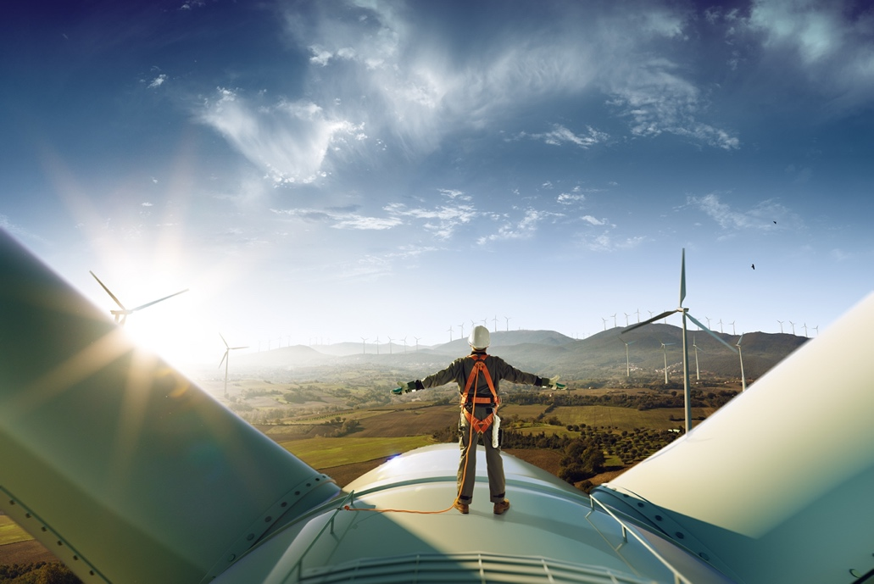
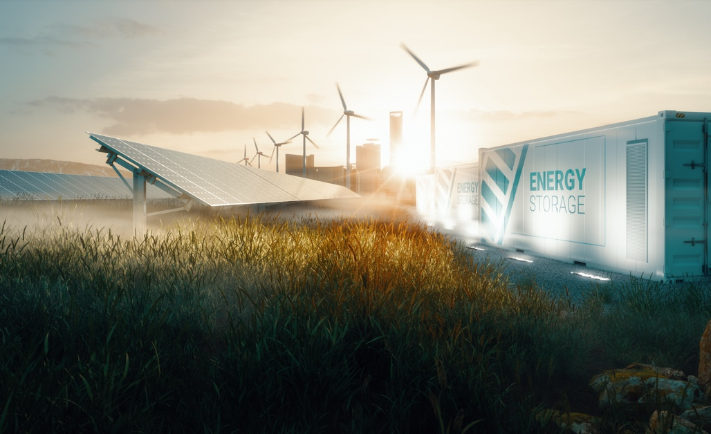
Our service areas at a glance
Solar
Wind
Grids & Storage
Business Case-Development
Basic Design
Finance Modelling
Structuring of Investment and Finance
Project Implementation Management
Installation
Operation & Maintenance
Installation of onshore wind turbines
Major components replacement for onshore wind turbines
Grid impact analysis​
Grid connection​
System integration​
Battery systems sizing​
Technical specifications​
Project implementation

Slide 4
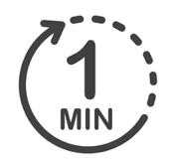
Optimizing Complex Renewable Solutions: Introducing in-house modelling tool AHEAD (Advanced Hybrid Energy Allocation & Dispatch)
Techno-economic Optimization
Amortization: inbuilt cash flow based financial model to calculate financial KPIs like LCOE, IRR, NPV, ROI
Optimization finds the lowest generation cost configuration
Decision process support
Economics vs. strategy – make a conscious decision
Visualize renewable generation vs. Mine load
Run multiple scenarios to determine the best solution
Hybrid system analysis
Simulation tool for grid connected and off grid hybrid systems
Wind, solar, PV and battery
Off-grid (gensets) or grid connected
Determine optimized renewable share & carbon emission reduction
Time-efficient modeling
Simulation in up to 1 minute time resolution
Multi year simulations for whole project lifetime
Tailored system sizing to meet load requirements
Customizable and user defined dispatch strategies

Slide 5
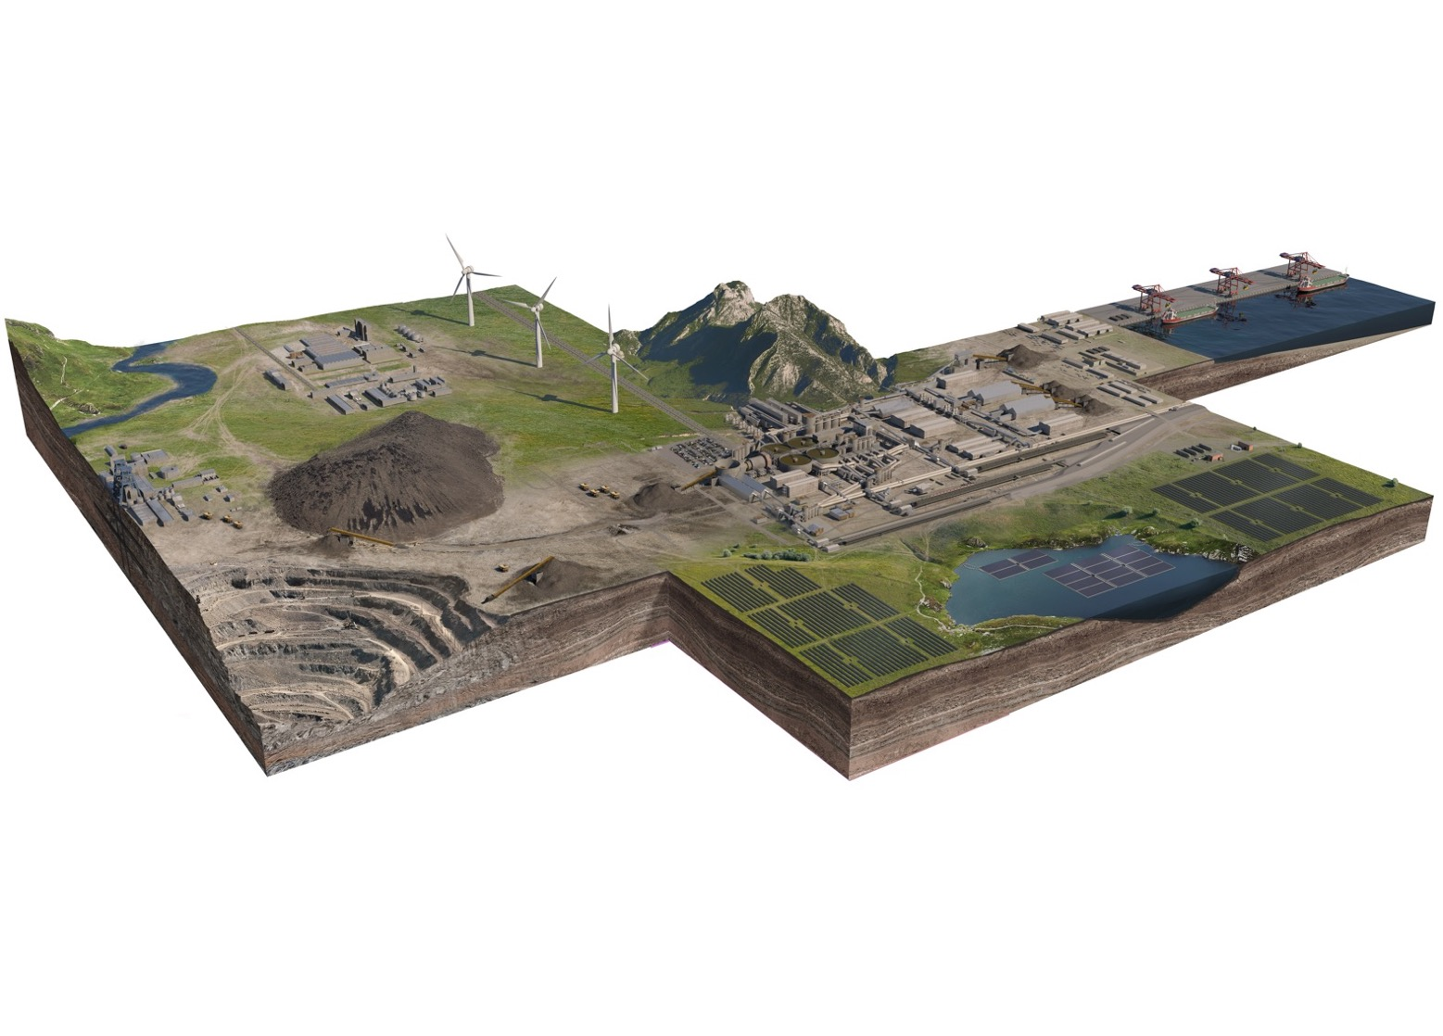
Industrial Decarbonization with Renewables: strong focus on mines
Needs analysis
Mine‘s energy requirements,
generation cost, grid stability
Renewable resources
Solar, Wind, Hydro etc.
(on-site, off site)
Financial requirements
On-balance EPC, off-balance, IPP Rental / Lease
Technology options
PV, Wind, Energy Storage, Grid Connection
Optimized concept
Technical Concept & Sizing / Economics / Timeline
Competitive selection
Procurement of RE Plant or PPA
Implementing
Building of the RE Project

Slide 6
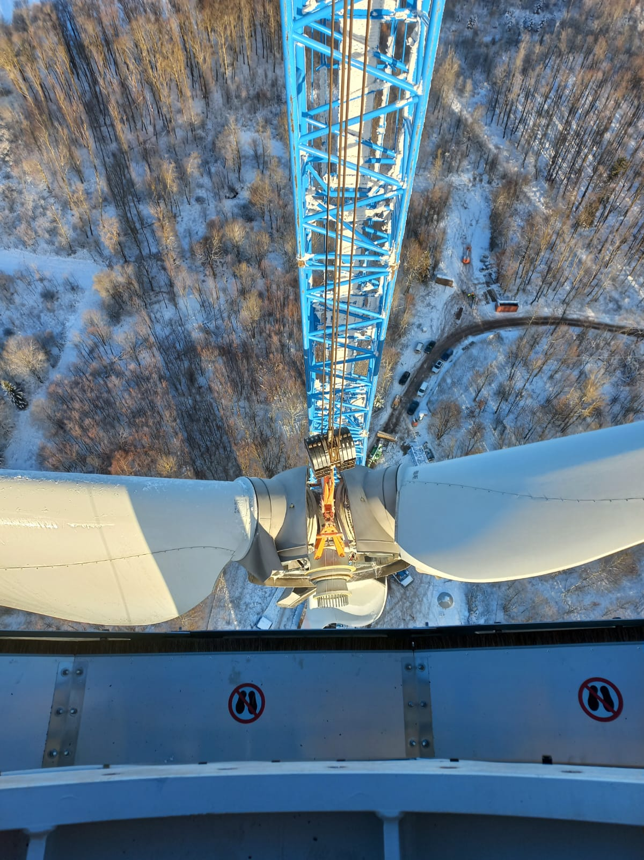
Wind highlights: strong focus on wind installation
Installation of onshore wind turbines
Expertise with installation of Enercon and Nordex wind turbines
Expertise with major components replacement of Enercon wind turbines
Expertise with working in various countries within EU

Slide 7
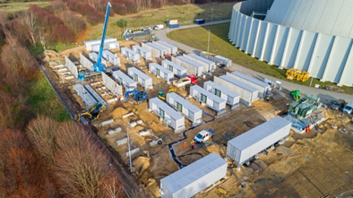
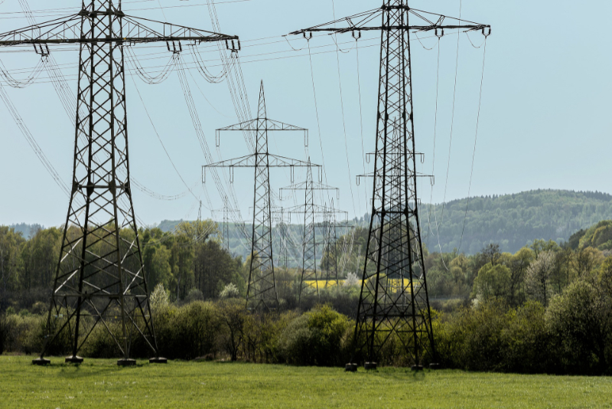
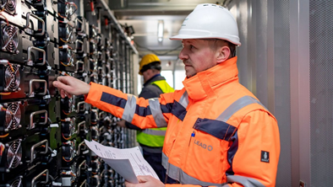
Grids & Storage highlights
Grids
Mains connection
System integration
Analysis of impacts on the power grid
Project implementation
Battery & Storage
Dimensioning of battery systems
Technical specifications
Project implementation

Slide 8
Hisham Ramahi
Business Relationship Manager
hisham.ramahi@dornier-group.com
00966565135876 00962796510519

Slide 9
Raed Romhi
Head of MENA region
Raed.romhi@dornier-group.com
+962 (0)77 9999 007 +971 (0)56 2299 007

Slide 10
André Zarse
Division Manager of Electrical- I&C
andre.zarse@dornier-group.com
+49 172 3517649

