Slide 1
A strong infrastructure service provider
Management presentation
May 2023

Slide 2
Our vision of the future
Introduction of the
Innovation process
At Dornier Group, internally generated innovations innovations are to be recorded in a structured initial evaluation. This forms the basis for a subsequent subsequent comprehensive evaluation process.
At Dornier, we want to orient ourselves strategically and operationally with the "growth fields of tomorrow" that are emerging as a result of the electricity, heat, transport and water transition and thus make our contribution to a sustainable future.
YouTube
Dornier Group Presentation
2

Slide 3
The Dornier Group has grown
Acquisition Vattenfall Europe Power Consulting (VPC) today: Dornier Power and Heat GmbH
Acquisition of 50 % of Encotec Energy (India) Pvt. Ltd.
2014
Foundation of Conwico GmbH today: Dornier Construction and Services GmbH
2016
Acquisition Dornier Consulting International GmbH
2017
Acquisition of 50 % of Suntrace GmbH today: Dornier Suntrace GmbH
2018
Foundation of VPC Nukleare Dienstleistungen GmbH, today: Dornier Nuclear Services GmbH Integration of BFUB into Dornier Power and Heat GmbH
2019
Acquisition of IBS Technik GmbH and integration into Dornier Construction and Services GmbH, Foundation of Dornier Group India and DCS Romania
2020
2021

Slide 4
Company and knowledge united in five Business Units
MOBILITY
WATER
NUCLEAR SERVICES
POWER AND HEAT
RENEWABLES
The designers
of mobility
The specialists
for water resources
The professionals
for nuclear technology
The experts for energy
The companions
the energy turnaround
Railroad Systems & Logistics
Water Supply &
Wastewater Management
Deconstruction Planning
Engineering
Solar
Mobility Strategies & Transport Systems
Strategic Reservoirs
Disposal Planning
O&M Germany
Wind
Green Transport
incl. E-Mobility
Monitoring
Nuclear Waste Management
O&M International
Grids & Storage
Aviation & Airports
Groundwater
Management
Repository Documentation
Real Estate Management
Radiation Protection

Slide 5
Dornier is the leading brand
Management
Dr. Ralf Gilgen / Patrick Rauh
BU Mobility
Christoph Gipp
BU Water
Ulrich Schott
BU Nuclear Services
Dr. Anton Anthofer
BU Power and Heat
Dr. Daniel Seibt
BU Renewables
Tolga Özkarakas
Mobility
Christoph Gipp
Water
Ulrich Schott
Engineering
Dr. Anton Anthofer
Engineering
Dr. Daniel Seibt
Solar
Boris Westphal
Real Estate Management
Dr. Marcus von Drygalski
Radiation Protection
Dr. Goswin Schreck
O&M Germany
Ralph Thilo / Yvonne Groth
Wind
Tolga Özkarakas
O&M International
Arun Sarna
Grids & Storage
André Zarse

Slide 6
The Dornier Group stands for
60 years
of market experience
EUR 80 million
sales in 2021
1,100 projects
per year
2,000 employees
worldwide
21 subsidiaries
distributed over
9 countries
inside and outside Europe

Slide 7
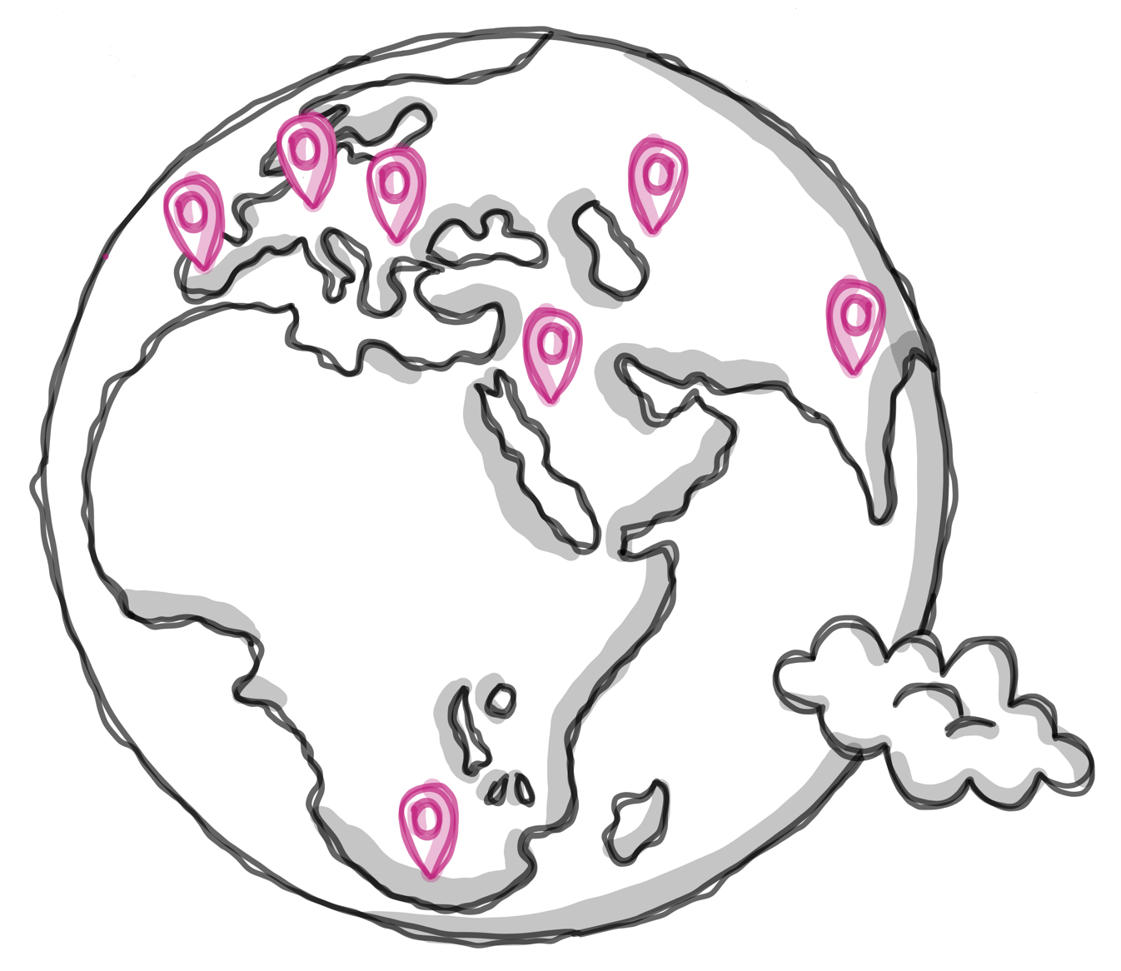
The Dornier Group is present worldwide
Southeast/ Eastern Europe
Astana
Belgrade
Constanta
Kiev
Southeast Asia & India
Gurugram
Noida, Uttar Pradesh
Germany
Berlin
Dresden
Hamburg
Leipzig
Muelheim an der Ruhr
Munich
Neubrandenburg
Stuttgart
Vetschau
MENA
Abu Dhabi
Doha
Dubai
Riyadh
Dornier Group Präsentation
7

Slide 8
Our common mission statement
We advise our clients on complex projects and implement novel technologies in the infrastructure sector.
We stand for sustainable and comprehensive solutions across industries and institutions - in the three megatopics of mobility, energy and water.
We build on our strength of over 60 years of realizing innovative ideas.
We create an inspiring environment for the development of our employees.

Slide 9
Mobility Business Unit
EUR 10.8 million
sales in 2021
110 projects
we realize on average per year
60 employees
are currently working in the Business Unit
Our services
include, among others:
Railroad Systems & Logistics
Mobility Strategies & Transport Systems
Green Transport & E-Mobility
Aviation & Airports
Real Estate Management
Milestones
Integrated Transport Model Saudi Arabia
Financing Instruments for Green Transition in Indonesia's Infrastructure Sector
Expansion of BMW Research and Innovation Center

Slide 10
Business Unit Water
EUR 6.2 million
sales in the past year 2021
25 projects
we realize on average per year​
30 employees
are currently working in the Business Unit
Our services
contain among others:
Natural water resources
Monitoring and Hydro-meteorological monitoring networks
Strategic water storage
Water infrastructure
Stormwater and sewage management
Groundwater remediation, resources assessment and management
Environmental data management
Milestones
World-largest strategic water storage and recovery project
Sustainable water supply for on-shore oil filed operations

Slide 11
Business Unit Nuclear Services
EUR 4.1 million
sales in 2021
40 projects
we realize on average per year
35 employees
are currently working in the Business Unit
Our services
contain among other things:
Disposal planning
Nuclear waste management
Repository documentation
Deconstruction planning
Radiation protectors for operation and dismantling
Milestones
Gundremmingen NPP: RPV+E disposal
NPP Grohnde: RBZ planning
NPP Brunsbüttel and Krümmel: RPV and control rod drive disposal

Slide 12
Business Unit Power and Heat
EUR 50.7 million
sales in the past year 2021
860 projects
we realize on average per year
1,800 employees
are currently working in the business unit, of which approx. 1,500 at Encotec in India
Our services
contain among other things:
Project management
Plant and process engineering
Electrical and control technology
Environment
Operation support services
Operational management
Milestones
General planning of CO2 separation at the waste incineration Delfzijl
Planning of energy centers In Potsdam, Krampnitz and Bochum
Owner’s engineering for the high voltage grid in the Gulf region

Slide 13
Business Unit Renewables
EUR 3.1 million
sales in 2021
70 projects
we realize on average per year
60 employees
are currently working in the business unit
Our services
include, among others:
Solar PV solutions, design and construction
Wind installation and major components replacement
Grid & Storage solutions
Milestones
40 Projects in Solar and Wind with a capacity close to 4 GW
4 Airport Decarbonisation projects and 7 Mining Decarbonisation projects
5 Floating PV projects
13 wind turbines installed in Norway and Germany
Designed by Freepik*
Notes:
*Source: <a href="https://de.freepik.com/fotos-kostenlos/3d-windmuehlenprojekt-zum-energiesparen_13328751.htm#page=4&query=solar%20energy&position=7&from_view=search&track=ais">Freepik</a>

Slide 14
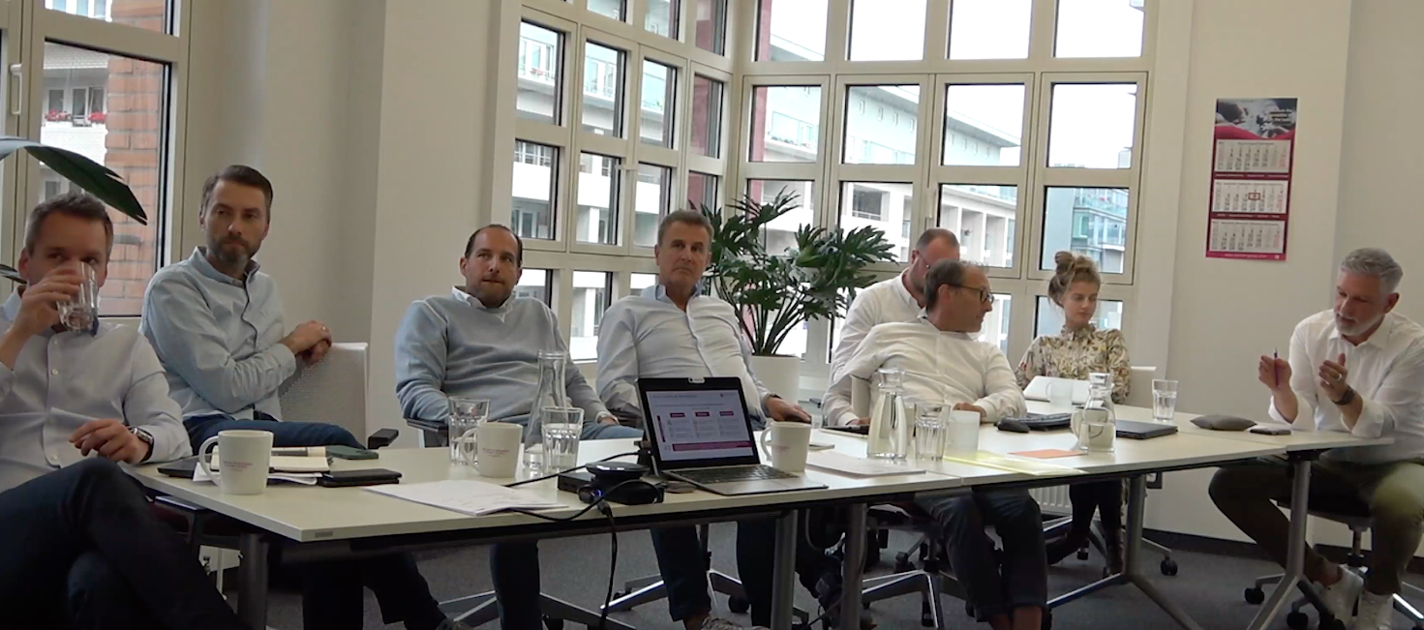
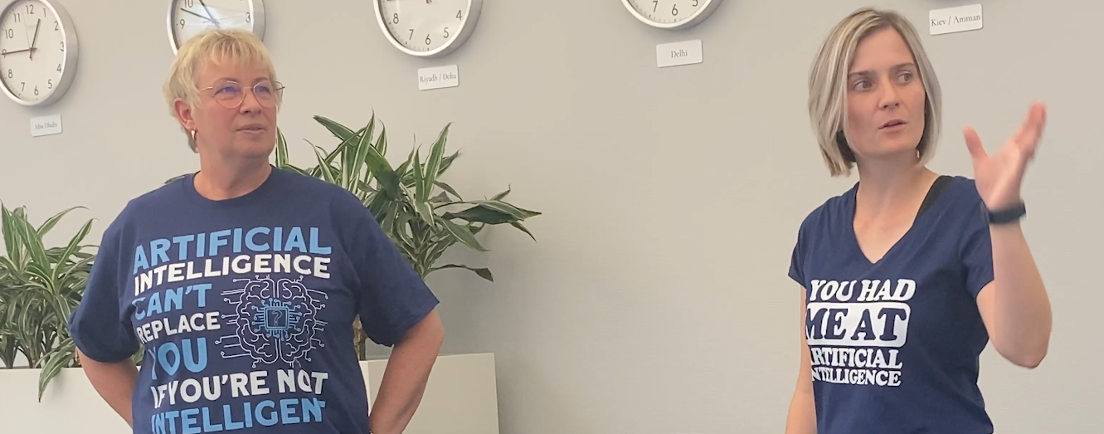
Our Innovation Hub
Our Innovation Hub within Dornier is designed to foster the creative potential of employees, systematically capture new ideas and thus create market-ready innovations.
32
Ideas
7
Pitches
2
Vali-dations
1
Prototyping
Dornier Group Presentation
14

Slide 15
Dornier Academy
We will share our know-how worldwide in the context of advanced training and continuing education.
First projects successfully completed:
Power and Heat: "Modern heating industry - international trends and challenges for the Republic of Kazakhstan" (cooperation with Kazakhstan University).
Nuclear Services: Graduate college with TU Dresden on the dismantling of power plants
Podcast on the basics of nuclear technology
Water: Introduction into Hydrogeology & Numerical Groundwater Modeling
Further expansion of activities and coordination of strategies and training programs ongoing
Dornier Group Presentation
15

Slide 16
Hisham Ramahi
Business Relationship Manager
hisham.ramahi@dornier-group.com
00966565135876 00962796510519

Slide 17
Raed Romhi
Head of MENA region
Raed.romhi@dornier-group.com
+962 (0)77 9999 007 +971 (0)56 2299 007

Slide 18
André Zarse
Division Manager of Electrical- I&C
andre.zarse@dornier-group.com
+49 172 3517649

